Slide 1
أكـــــاديميــــة طــــويـــق
Deep Learning

Slide 2
Recurrent Neural Network
By: Dr. Afshan Hashmi

Slide 3
Course Objectives:
Understand the fundamental principles and architecture of Recurrent Neural Networks (RNNs) for processing sequential data.
Identify and explain the challenges of vanishing and exploding gradients in training deep RNNs.
Analyze and compare different techniques for mitigating the vanishing and exploding gradient problems, including specialized RNN architectures like LSTMs and GRUs.
Implement and apply various strategies, such as non-linear activations, gradient clipping, and regularization, to effectively train RNN models.
Evaluate the performance of different RNN models on various sequence-based tasks and understand their strengths and limitations.

Slide 4
Recurrent Neural Network (RNN)
A Recurrent Neural Network (RNN) is a type of deep neural network specifically designed and trained to process sequential data or time series data. Its primary goal is to build machine learning models that can make predictions or draw conclusions based on the ordered nature of the input.
Language Translation: Understanding the sequence of words in one language to generate a sequence in another.
Natural Language Processing (NLP): Tasks like understanding text meaning, generating text, and question answering.
Sentiment Analysis: Determining the emotional tone (positive, negative, neutral) of a sequence of text.
Speech Recognition: Transcribing a sequence of audio signals into a sequence of words.
Image Captioning: Generating a sequence of words that describes the content of an image.
The core strength of RNNs lies in their ability to maintain an internal "memory" of previous elements in the sequence, allowing them to understand context and dependencies over time.

Slide 5
Recurrent Neural Networks (RNNs) for sequential data
RNNs are a type of neural network specifically designed for sequential data.
Their power comes from considering not just the current input but also previous inputs, enabling them to "remember" prior information.
Contrast with Traditional Methods (e.g., Naive Bayes for text classification):
Traditional methods often treat text as a collection of independent words, focusing on frequency.
They disregard word order and composition, which are crucial for sentence meaning.
RNN Approach:
Processes sequential data element by element (e.g., words in a sentence).
Combines the current input (word i) with the output from the previous element (word i-1).
This process is repeated for subsequent elements (word i+1).
The repeated application of the same operations on each element in the sequence is why it's called a "recurrent" neural network.
This mechanism allows RNNs to understand context and dependencies within the sequence.

Slide 6
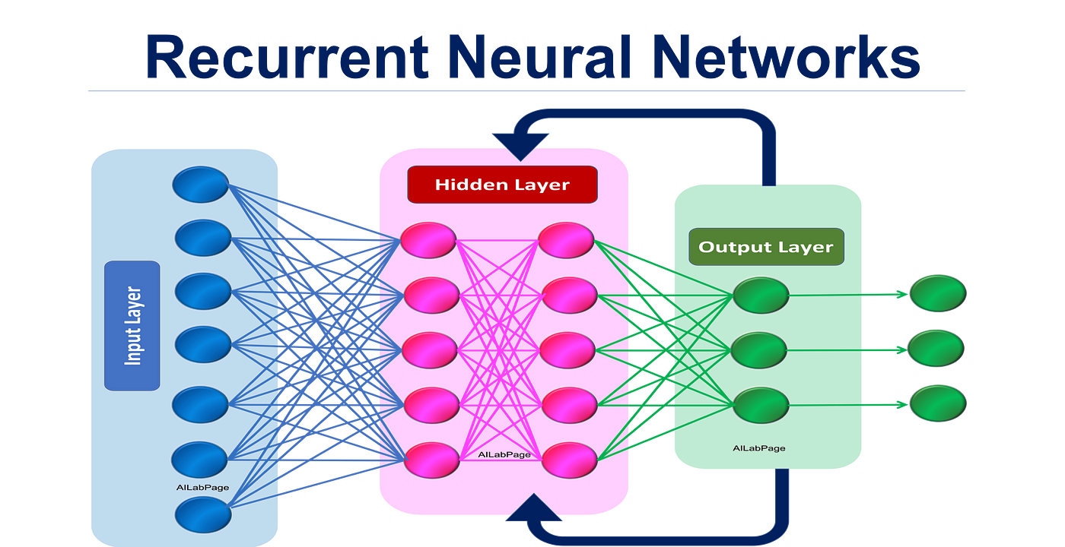
Recurrent Neural Network (RNN)

Slide 7
How Recurrent Neural Network (RNN) Works
Learning from Sequential Data: Like other neural networks (feedforward and CNNs), RNNs learn patterns from training data.
"Memory" Mechanism: RNNs have a key difference: they use information from prior inputs to influence the processing of the current input and the resulting output.
Dependence on Prior Elements: Unlike traditional networks that assume input and output independence, the output of an RNN depends on the elements that came before in the sequence.
Unidirectional Limitation: Basic RNNs (unidirectional) cannot account for future elements in the sequence when making predictions about the current element.

Slide 8
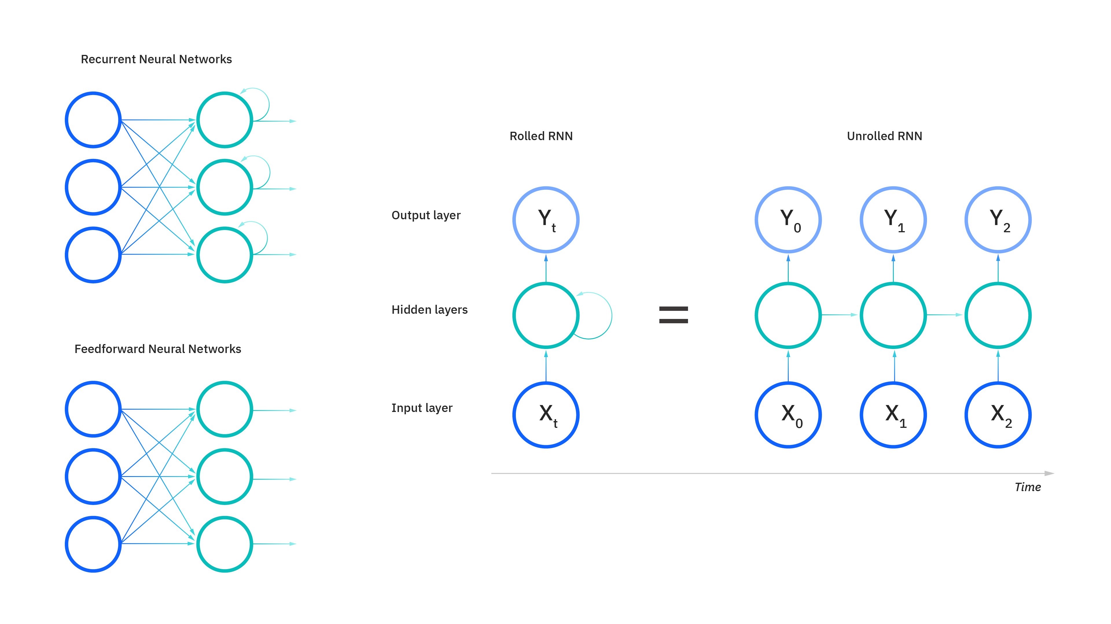
How Recurrent Neural Network (RNN) Works
Hidden State for Context: RNNs maintain a "hidden state" at each time step to track context within the sequence.
Feedback Loop: The hidden state from one time step is passed as input to the next, creating a feedback loop.
Processing at Each Step: At each step, the RNN processes the current input (e.g., a word) along with the hidden state from the previous step. This allows it to "remember" past data points.

Slide 9
How Recurrent Neural Network (RNN) Works
Parameter Sharing: RNNs share the same weight parameters across each layer of the network at different time steps. This is unlike feedforward networks, which have different weights for each node in a layer.
Weight Adjustment: These shared weights are still learned and adjusted through backpropagation and gradient descent.
Backpropagation Through Time (BPTT): RNNs use a specialized training algorithm called Backpropagation Through Time (BPTT) to calculate gradients for sequence data.
BPTT's principles are similar to traditional backpropagation, where errors are calculated from the output layer back to the input layer to adjust model parameters.
BPTT differs by summing the errors at each time step, which is necessary because the parameters are shared across the sequence, unlike feedforward networks.

Slide 10
Common Activation Functions:
Sigmoid Function:
Used to interpret output as probabilities or to control gates (how much information to keep or discard).
Prone to the vanishing gradient problem, making it less suitable for deeper networks.
Tanh (Hyperbolic Tangent) Function:
Often used because its output is centered around zero, which can improve gradient flow and the learning of long-term dependencies.
ReLU (Rectified Linear Unit):
Its unbounded nature can potentially lead to exploding gradients.
Variants like Leaky ReLU and Parametric ReLU have been used to address some of these issues.

Slide 11
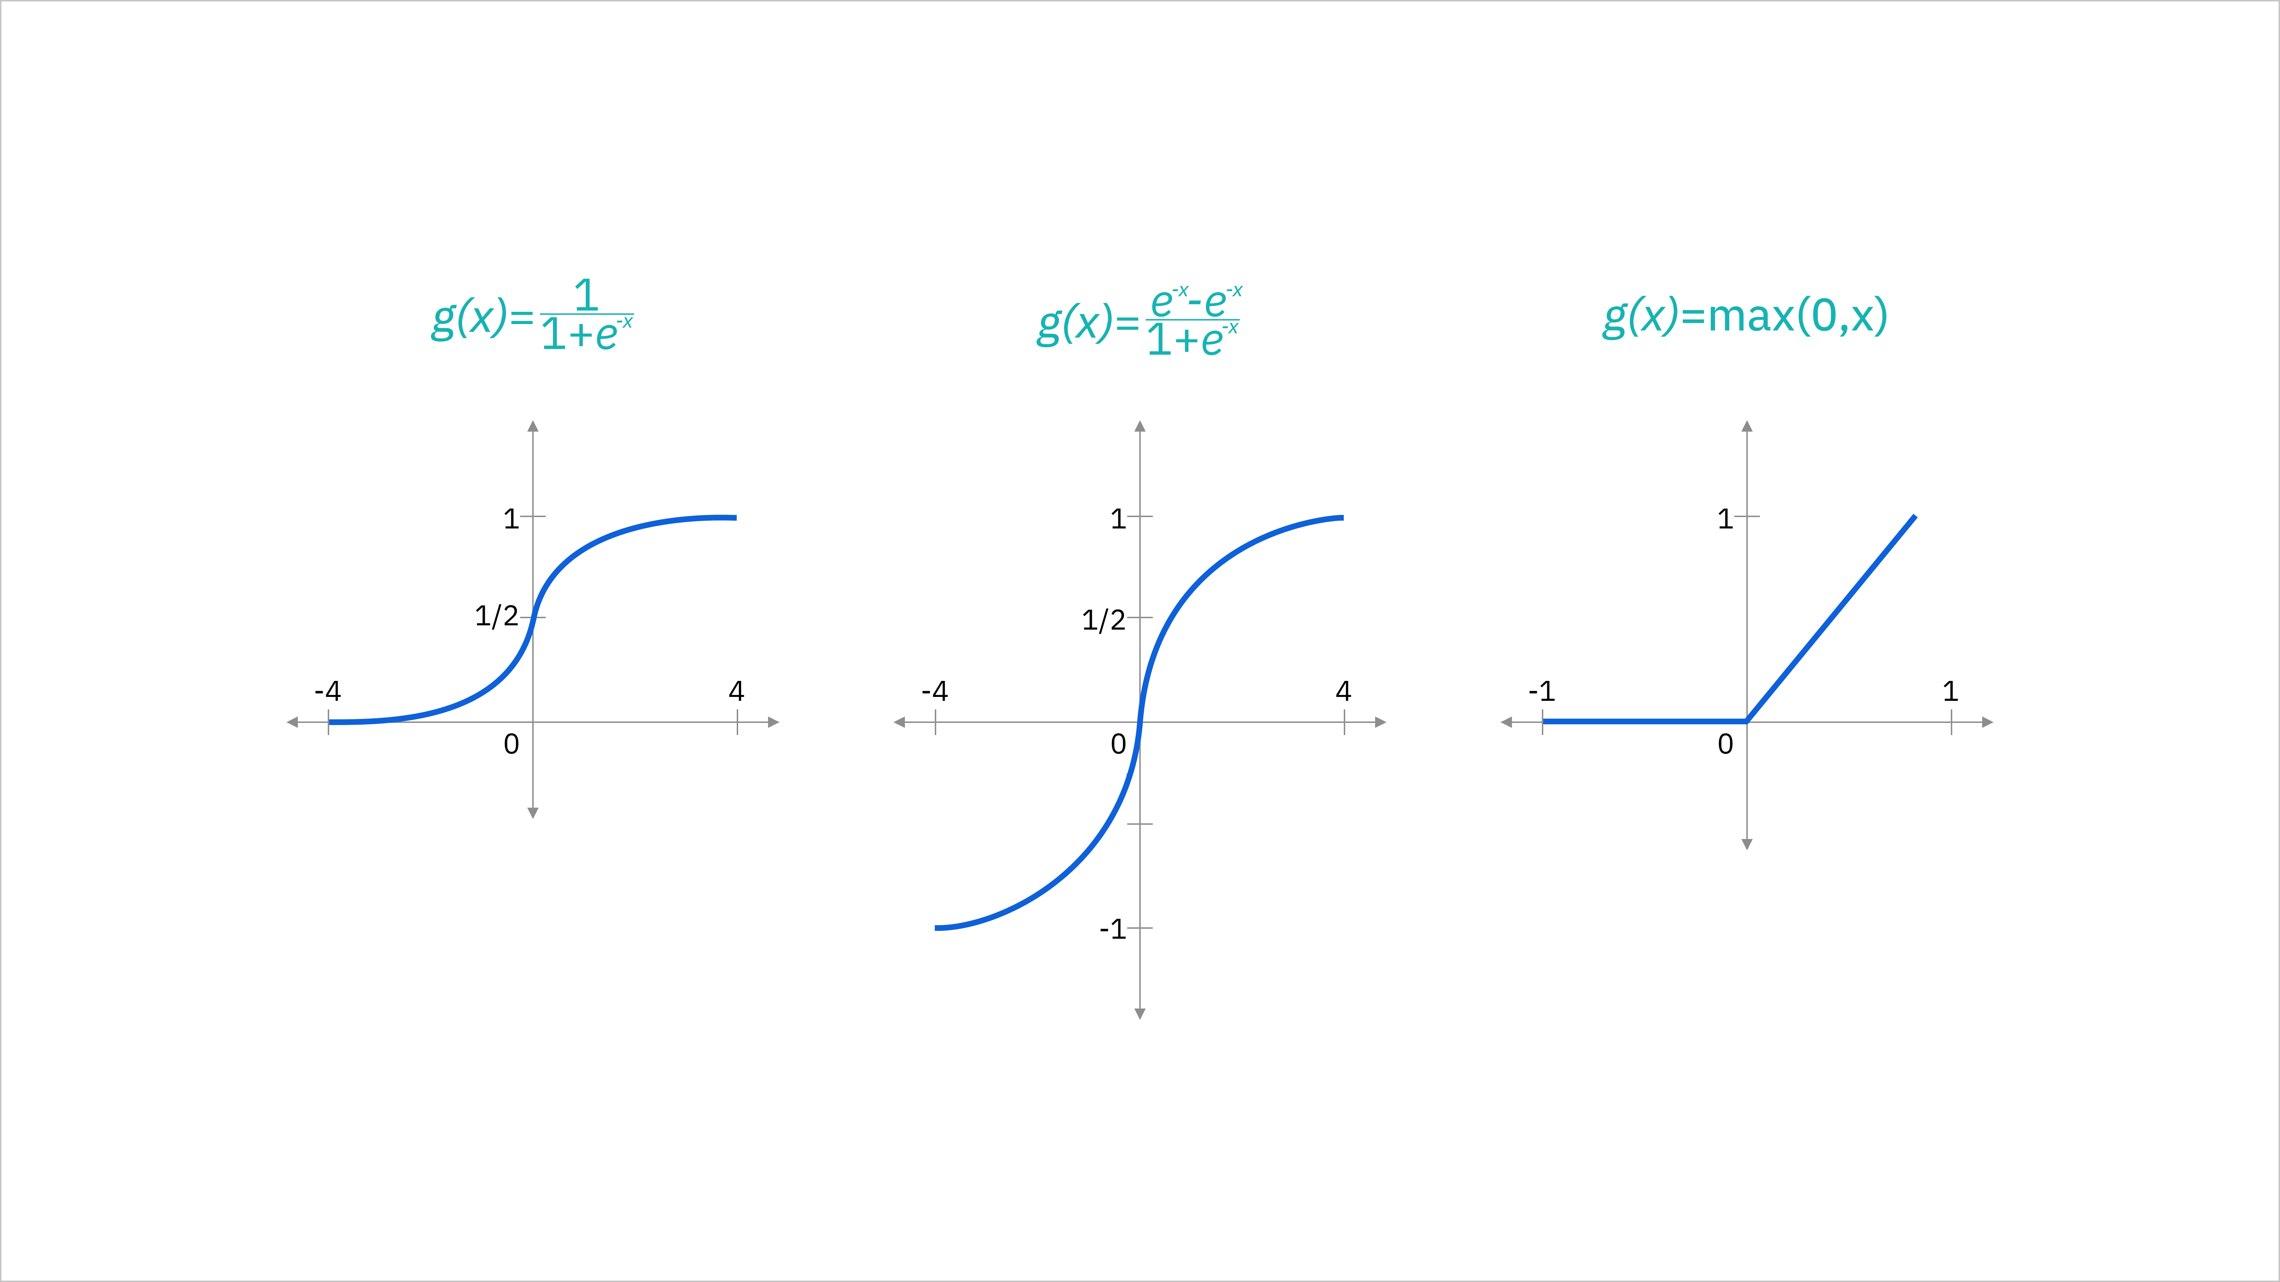
Purpose of Activation Functions:
Introduce non-linearity, enabling the network to learn complex patterns in sequential data (like NLP and time series).
Without them, RNNs would only perform linear transformations.
Control the magnitude of neuron outputs, keeping values within a specific range to prevent exploding or vanishing gradients.
Application in RNNs: Applied at each time step to the hidden states, regulating how the network updates its memory based on current input and past states.
Sigmoid
tanh
ReLU

Slide 12
Types of RNNs
Feedforward networks map inputs and outputs one-to-one, and while we’ve visualized recurrent neural networks in this way in the diagrams before this, they do not have this constraint. Instead, their inputs and outputs can vary in length, and different types of RNNs are used for different use cases, such as music generation, sentiment classification and machine translation.
Popular recurrent neural network architecture variants include:
Standard RNNs
Bidirectional recurrent neural networks (BRRNs)
Long short-term memory (LSTM)
Gated recurrent units (GNUs)
Encoder-decoder RNN

Slide 13
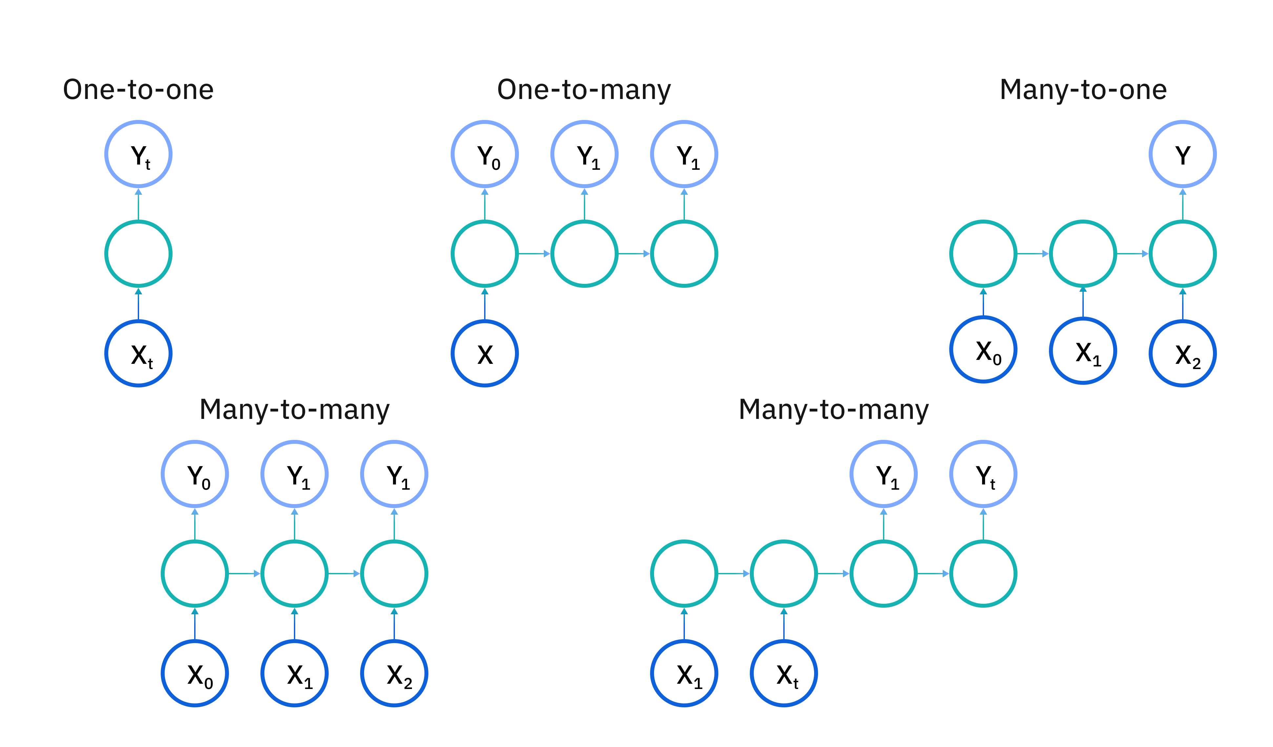
Types of RNNs
RNNs can be structured in various ways to suit different tasks:
One-to-One: Standard neural network (e.g., image classification).
One-to-Many: Single input, sequence output (e.g., image captioning).
Many-to-One: Sequence input, single output (e.g., sentiment analysis).
Many-to-Many (Same Length): Sequence input and output of the same length (e.g., named entity recognition).
Many-to-Many (Different Length): Sequence input and output of different lengths (e.g., machine translation).

Slide 14
Variants of RNNs
1. Standard (Unidirectional) RNNs:
Working: The output at each step is determined by the current input and the hidden state from the previous step.
Limitations:
Suffer from the vanishing gradient problem, hindering their ability to learn long-term dependencies.
Excel in tasks with short-term dependencies.
Good For: Real-time sequential data processing where predictions are made immediately based on the most recent inputs (e.g., short-term anomaly detection in sensor data, predicting the next word in simple, short sentences).
2. Bidirectional RNNs (BRNNs):
Working: Unlike unidirectional RNNs that only consider past inputs, BRNNs incorporate information from future data points as well to make predictions about the current state.
Benefit (Example): In the idiom "feeling under the weather," a BRNN can better predict "under" by considering that the sequence ends with "weather."
Advantage: Improved accuracy by leveraging context from both directions of the sequence.

Slide 15
Variants of RNNs
3. Long Short-Term Memory (LSTM):
Problem Addressed: Vanishing gradient problem in standard RNNs, enabling the learning of long-term dependencies.
Mechanism: Introduces "cells" in the hidden layers with three gates:
Input Gate: Controls the flow of new information into the cell state.
Output Gate: Controls the flow of information from the cell state to the output.
Forget Gate: Controls which information to discard from the cell state.
Cell State: Acts as a memory to store information over long sequences.
Example: In the sentence "Alice is allergic to nuts. She can't eat peanut butter," the LSTM can retain the information about the nut allergy from the first sentence to correctly predict "peanut butter" in the second.

Slide 16
Variants of RNNs
4. Gated Recurrent Units (GRUs):
Similar to LSTM: Also addresses the short-term memory problem of RNNs.
Mechanism: Uses hidden states (instead of a separate cell state) and two gates:
Reset Gate: Determines how much of the previous hidden state to forget.
Update Gate: Determines how much of the previous hidden state to update with the current input.
Computational Efficiency: Simpler architecture than LSTMs, leading to fewer parameters and faster training.
Suitability: Often more suitable for real-time or resource-constrained applications.
5. Encoder-Decoder RNNs:
Common Use: Sequence-to-sequence tasks like machine translation.
Encoder: Processes the input sequence and compresses it into a fixed-length vector called the "context."
Decoder: Uses the context vector to generate the output sequence.
Bottleneck: The fixed-length context vector can become a bottleneck, especially for very long input sequences, as it tries to capture all the necessary information in a single vector.

Slide 17
Limitations of RNN
Simple RNN models usually run into two major issues. These issues are related to gradient, which is the slope of the loss function along with the error function.
Vanishing Gradient problem occurs when the gradient becomes so small that updating parameters becomes insignificant; eventually the algorithm stops learning.
Exploding Gradient problem occurs when the gradient becomes too large, which makes the model unstable. In this case, larger error gradients accumulate, and the model weights become too large. This issue can cause longer training times and poor model performance.
The simple solution to these issues is to reduce the number of hidden layers within the neural network, which will reduce some complexity in RNNs. These issues can also be solved by using advanced RNN architectures such as LSTM and GRU.

Slide 18
Vanishing Gradient Problem:
During backpropagation, the derivatives (slopes) of activation functions become progressively smaller as error signals are passed backward through the network's layers.
Impact on Deep Networks: This is especially significant in deep networks with many layers, hindering effective training.
Insignificant Weight Updates: As gradients become very small (or exponentially small), the updates to the network's weights become negligible.
Prolonged or Halted Training: This can drastically increase training time or even stop the learning process altogether.
Why it Occurs:
Gradients decrease significantly as they propagate from the output layer back to the input layer.
Weights in early layers receive these small gradients, leading to minimal or no updates during optimization.

Slide 19
Vanishing Gradient Problem:
Association with Sigmoid and Tanh: The sigmoid (derivative range 0-0.25) and tanh (derivative range 0-1) activation functions are particularly prone to this. Extreme weight values can lead to very small derivatives.
Saturation of Activation Functions: Sigmoid (output 0-1) and tanh (output -1 to 1) saturate at their extreme values. When neuron inputs fall into these saturated regions (very small or very large), their derivatives approach zero.
Multiplicative Effect in Deep Networks: In deep networks, these small gradients are multiplied across layers during backpropagation, causing them to decay significantly. This results in the early layers learning very slowly and hinders overall model performance, potentially leading to a failure to converge.

Slide 20
How to Identify the Vanishing Gradient Problem:
Weight Convergence or Stagnation: Observe if the model's weights are approaching zero or if their values are barely changing over many training epochs.
Performance Plateau: Monitor the model's performance metrics (like accuracy or loss) on the training and validation sets. If these metrics stop improving significantly or plateau early in training, it could indicate vanishing gradients preventing further learning.
Erratic Learning Curves: Look for unusual or unstable behavior in the training and validation loss curves. This might manifest as large fluctuations or a failure to consistently decrease.
Gradient Analysis: Directly examine the gradients during backpropagation, if your framework allows this.
Visualization: Use techniques like gradient histograms or calculate the L2 norm of the gradients for different layers. Vanishing gradients would show as gradients with very small magnitudes, especially in the earlier layers of deep networks.

Slide 21
How to Address the Vanishing Gradient Problem:
Batch Normalization: Normalizes the inputs of each layer, reducing internal covariate shift. This stabilizes and speeds up training, promoting more consistent gradient flow.
Activation Functions (ReLU and its variants): Using activation functions like ReLU helps because its gradient is 1 for positive inputs (avoiding gradient shrinkage) and 0 for negative inputs (which can help with sparsity). Variants like Leaky ReLU and Parametric ReLU address the "dying ReLU" problem where neurons can become inactive.
Skip Connections and Residual Networks (ResNets): These connections allow gradients to bypass intermediate layers during backpropagation, ensuring a more direct flow of information and preventing gradients from becoming too small.
Long Short-Term Memory Networks (LSTMs) and Gated Recurrent Units (GRUs): Specifically designed for Recurrent Neural Networks (RNNs), these architectures incorporate gating mechanisms that control the flow of information and gradients through the sequential data, mitigating the vanishing gradient problem over time.
Gradient Clipping: Imposing a threshold on the magnitude of gradients during backpropagation prevents them from becoming excessively large (exploding gradients) or, indirectly, from becoming infinitesimally small due to the scale of the network.

Slide 22
Exploding Gradient Problem
The exploding gradient problem is a challenge in training deep neural networks where the gradients of the loss function with respect to the network's weights become excessively large during backpropagation.
Why Exploding Gradient Occurs
This issue arises because the derivatives of the network's layers grow exponentially as backpropagation proceeds from the output layer towards the input layer.
The primary cause is high weight values within the network. Large weights lead to large derivatives, causing significant and unstable updates to the weights.
This can prevent the gradient from converging, leading to oscillations around local minima and hindering the network's ability to learn effectively and reach the global minimum.
Mathematical Representation of the Weight Update
The update rule for the weights during backpropagation is given by:
ΔW_{i} = -α ⋅ ∂L/∂W_{i}
where:
Δ W_{i} : The change in the weight W_{i}.
α: The learning rate (a hyperparameter).
L: The loss function.
∂L​/∂W_{i}​: The partial derivative of the loss function with respect to the weight W_{i} (the gradient).
The exploding gradient problem becomes significant when the absolute value of the gradient is greater than 1:

Slide 23
How to Identify the Exploding Gradient Problem:
Erratic Loss Function Behavior: Observe the training loss. If it oscillates wildly or increases significantly instead of consistently decreasing, it's a strong indicator of exploding gradients. Large gradient updates cause the network to overshoot optimal values, leading to this unstable behavior.
"NaN" Values: The appearance of "NaN" (Not a Number) values in the loss function or other intermediate calculations during training is a critical sign. Exploding gradients can lead to extremely large numbers that exceed the representational capacity of floating-point numbers, resulting in "NaN".
Large Weight Updates: Monitor the magnitude of weight updates during training. If you notice that the weights are changing drastically and rapidly, it suggests that the gradients are very large and causing these significant adjustments.
Gradient Monitoring Tools (e.g., TensorBoard): Utilize visualization tools like TensorBoard to inspect the gradients flowing through different layers of the network. Abnormally large gradient values in certain layers are a direct indication of the exploding gradient problem.
In essence, look for signs of instability and excessively large values during the training process, both in the overall loss and within the network's internal parameters (weights and gradients).

Slide 24
How can we solve the issue?
Gradient Clipping: It sets a maximum threshold for the magnitude of gradients during backpropagation. Any gradient exceeding the threshold is clipped to the threshold value, preventing it from growing unbounded.
Batch Normalization: This technique normalizes the activations within each mini-batch, effectively scaling the gradients and reducing their variance. This helps prevent both vanishing and exploding gradients, improving stability and efficiency.

Slide 25
Summary
Recurrent Neural Networks (RNNs) excel at processing sequential data by leveraging an internal memory state.
A key challenge in training RNNs is the vanishing gradient problem, where gradients shrink exponentially during backpropagation, hindering the learning of long-term dependencies.
The exploding gradient problem, conversely, involves gradients growing uncontrollably large, leading to unstable training.
Vanishing gradients arise from repeated multiplication of small gradients through time, especially with saturating activation functions.
Exploding gradients occur due to repeated multiplication of large gradients, often exacerbated by large weight values.
Long Short-Term Memory (LSTM) and Gated Recurrent Units (GRUs) are advanced RNN architectures designed to mitigate the vanishing gradient problem through gating mechanisms.
Techniques like ReLU activation, skip connections, weight initialization, and batch normalization also help address vanishing gradients.
Gradient clipping and weight regularization are common strategies to combat exploding gradients by limiting gradient size and penalizing large weights.
Addressing vanishing and exploding gradients is crucial for effectively training deep RNNs and enabling them to learn long-range patterns in sequential data.

Slide 26


Hands On Exercise
Click Here For The Implementation on Google Colab
https://drive.google.com/file/d/1PFRcwMSE9jDkYlX5PVytRvHLOLLQpylV/view?usp=share_link

Slide 27
Books and References
"Neural Networks and Deep Learning" (Michael Nielsen)
Deep Learning for Computer Vision (Rajalingappaa Shanmugamani)
https://www.geeksforgeeks.org/difference-between-feed-forward-neural-networks-and-recurrent-neural-networks/
Goodfellow, I., Bengio, Y., & Courville, A. (2016). Deep Learning. MIT Press.
Chollet, F. (2017). Deep Learning with Python. Manning Publications.
Hochreiter, S., & Schmidhuber, J. (1997). Long Short-Term Memory. Neural Computation.

Slide 28

















الشراكات العالمية

Slide 29
شــــــكــــرًا لكــــــم
THANK YOU

